Slide 1



Slide 2
Indexing

Slide 3
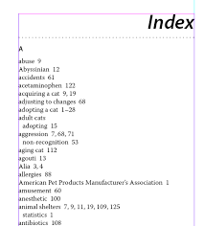
Index
Similar to index in books.
Speed up the retrieval of records in response to certain search conditions.
One or more fields in a record called the indexing fields are used to construct the index file.
Index files are smaller than the original file.

Slide 4
Index Structure
Entries in index files → index entries.
Index entries consists of two parts: search key and pointer
Search Key :
An attribute or set of attributes used to look-up (search) records in a file.
Need not to be primary key, candidate key or super key.
Pointer:
Points to the physical location of the record.
Several indices → several search keys.
Search Key | Pointer

Slide 5
Types of Indices
Ordered indices: search keys are stored in sorted order
Hash indices: search keys are distributed uniformly across “buckets” using a “hash function”.

Slide 6
Index Evaluation Metrics
Access types :
Finding records with a specified attribute value and finding records whose attribute values fall in a specified range.
Access time:
Time taken to find a particular data item
Insertion time:
Time taken to insert a new data item (i.e., finding the correct place + updating time)
Deletion time:
Time taken to delete a data item (i.e., finding the item + updating time)
Space overhead:
Additional space occupied by an index structure.

Slide 7
Ordered Indices
Stores the values of the search keys in sorted order and associates each search key with the records that contain it (through pointers).
Ordered indices can be of two forms:
1. Clustering index and
2. Non-clustering index
Clustering Index:
Also called as primary index
Both the records and search key of the records are sequentially stored.
If the index is created on the basis of the primary key of the table, then it is known as primary indexing. These primary keys are unique to each record and contain 1:1 relation between the records.
As primary keys are stored in sorted order, the performance of the searching operation is quite efficient.
The primary index can be classified into two types: Dense index and Sparse index.

Slide 8
Types of Primary Indices
Dense and Sparse Indices
Multilevel Indices

Slide 9
Dense Index
Index record appears for every search-key value in the file.
The index record contains the search key values and a pointer to the first data record with that search key value.
The rest of the records with the same search key value will be stored sequentially after the 1st record.
In this, the number of records in the index table is same as the number of records in the main table.
It needs more space to store index record itself. The index records have the search key and a pointer to the actual record on the disk.

Slide 10
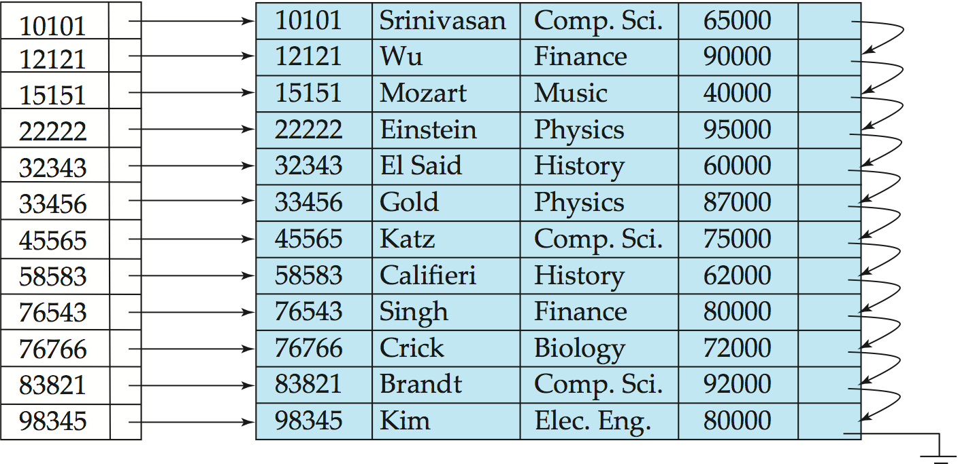
E.g. index on ID attribute of instructor relation

Slide 11
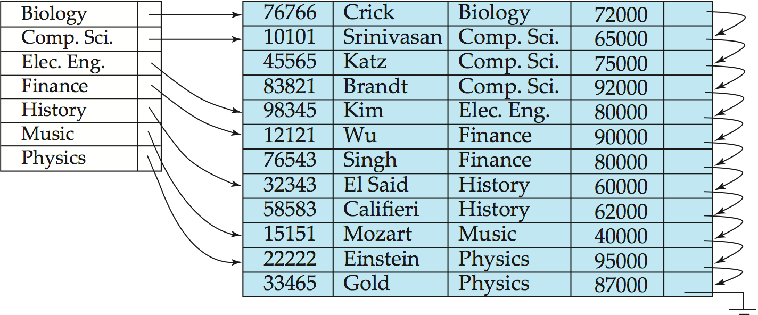
Eg: Dense index on dept_name, with instructor file sorted on dept_name

Slide 12
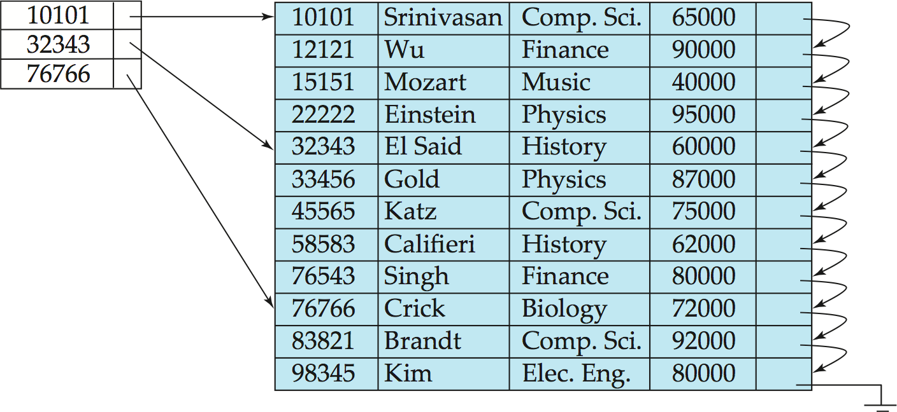
Sparse Index
The index record contains only some of the search key values and a pointer to the corresponding record.
We follow the pointers of nearly equal search key value until the desired record is found.
In this, instead of pointing to each record in the main table, the index points to the records in the main table in a gap.

Slide 13
Comparison
Dense index
Sparse index
Faster to locate a record
More space to construct index
Overhead during insertion and deletion
Generally slow
Less space to construct index
Less overhead for insertion and deletion

Slide 14
Multilevel Indices
As the size of database grows so does the size of indices.
There is an immense need to keep the index records in the main memory so that the search can speed up.
If single level index is used then a large size index cannot be kept in memory as whole and this leads to multiple disk accesses.
Multi-level Index helps breaking down the index into several smaller indices in order to make the outer most level so small that it can be saved in single disk block which can easily be accommodated anywhere in the main memory.

Slide 15
Contd..
Outer index – a sparse index of primary index
Inner index – the primary index file
If even outer index is too large to fit in main memory, yet another level of index can be created, and so on.
Indices at all levels must be updated on insertion or deletion from the file.

Slide 16
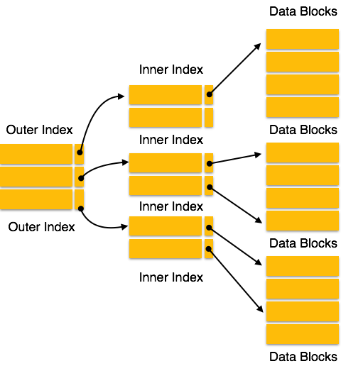

Slide 17
Secondary Indices
Non-clustering index
Search key values are not sequentially stored
The pointers in such a secondary index do not point directly to the record, instead the point to the bucket that contains pointer to the respective records.
Secondary indices have to be dense

Slide 18
Secondary index on salary field of instructor

